Slide 1
Lecture
CSS: Cascading Style Sheets

Slide 2
What are Styles?
Cascading Style Sheets (CSS) is a style sheet language used to describe the presentation semantics (the look and formatting) of a document written in a markup language.
Set of formatting rules
Defines how a website is rendered
Available Properties:
  Font and Text
  Paragraph and Margin
  Borders, Backgrounds and more...

Slide 3
Types of Styles
Inline Styles – Styles that you type “inline” with each tag
<h1 style="text-align: center;">
Internal Style sheets: Styles are defined for each page
<style type="text/css">
h1 {
color: purple;
}
</style>
External style sheets: Styles are defined and linked to the entire site.
<link rel="stylesheet" type="text/css" href="style.css">

Slide 4
Inline Styles
tag
attribute
property
value
color: green
>
style=" "
<h1
Welcome!</h1>
Welcome!
Or: Old School styles:
<h1 align=“center”>

Slide 5
Waste of Time
X
<h1 style="color: red"> Local </h1>
...
<h1 style="color: red"> County </h1>
...
<h1 style="color: red"> State </h1>
...
<h1 style="color: red"> Federal </h1>
...

Slide 6
External Style Sheets
Link pages to external definition of styles
Keep entire site matching
Easier to change style definitions all at once
Can also create special styles for mobile devices, accessibility devices, and printers

Slide 7
Style Sheet Syntax
tag (selector)you are defining, followed by {
p {
margin-left: 2em;
font-family: 'Trebuchet MS';
color: white;
}
declarer
list of attributes
separated by ;
closing }
attribute name: value
Notes:
Em – is the width of a capital M in whatever Font is being used….

Slide 8
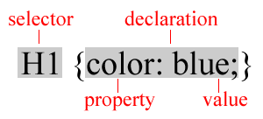
Rule Structure
Rule Structure

Slide 9
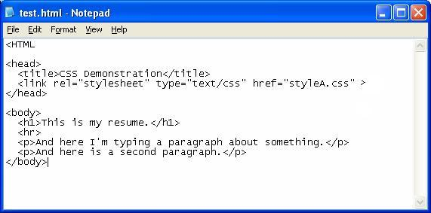
Linking to External Style Sheet
Link goes inside
<head> element
href
must match
style sheet
filename
<link rel="stylesheet" type="text/css" href="style.css">

Slide 10
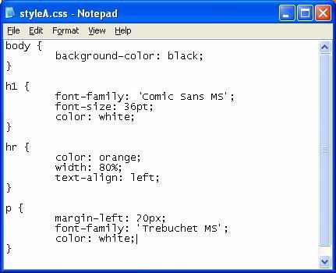
The Style Sheet File
tag redefined

Slide 11
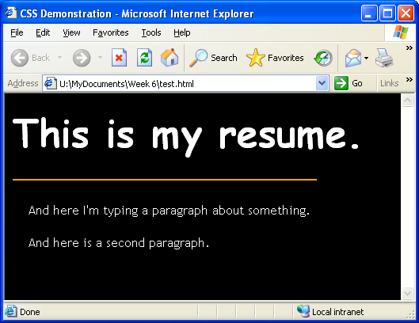

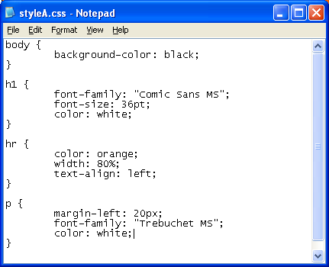
End Result

Slide 12
SAMPLES: Text Properties
Color
Text-align
Letter-spacing
Word-spacing
Font
Text-Decoration
Text-Transform
Line-Height
Links
Images
Backgrounds
Lists
Borders
Margins/Padding
Cascading Style Sheets (CSS): Pixel-Level Control with HTML Ease
Notes:
Cascading Style Sheets: Pixel-Level Control with HTML Ease
We’ve done a great deal with boxes and borders, but we haven’t talked a great deal about text. Text can do so many things!
This is not a comprehensive list. There are text properties that I decided to not include in this class. A block-level element is something that has an automatic carriage return after it. Boxes, <p>, <div>, these are block-level. To change text at the block level is a simple change in the CSS, as we’ve been doing. I’m going to show you a series of block-level text properties
It can have color, which we did very early on when we defined our
H2 {color: cyan;}
P {color: purple; }
[Read the bullets and comment briefly.]
Let’s start with letter spacing, which works rather nicely with headers.

Slide 13
Color
The color property can be specified 3 ways:
H1 { color: red;
}
Primary colors
*Hex color code
H1 { color: #FF0000;
}
RGB – red, green, blue
H1 { color: rgb(231,36,3);
}
Cascading Style Sheets (CSS): Pixel-Level Control with HTML Ease
Notes:
Cascading Style Sheets: Pixel-Level Control with HTML Ease

Slide 14

Text-Align
The text-align property can center, justify, or align text to the right or left.
H1 { color: #FF0000;
text-align: center; letter-spacing: 5px;
word-spacing: 15px;}
The letter-spacing property adds space between letters; The word-spacing property adds space between words.
Cascading Style Sheets (CSS): Pixel-Level Control with HTML Ease
Notes:
Cascading Style Sheets: Pixel-Level Control with HTML Ease
And maybe we want to have our H1s centered. Centering is accomplished using the text-align property. The value options are left, center, right, and justify. Go back in the CSS file, to the H1 rules and include the text-align property with a value of center. Save and refresh.
Don’t forget that even though we have only 1 H1 in our HTML page, it will effect all the H1s in the entire page and all the HTML pages connected to that style sheet. Since we are working with only one page, it can surprise you later when you didn’t plan on your other pages for all H1s to be affected.

Slide 15

Font
The font property defines the family, size, style, weight, and variants of fonts.
H1{
Font-family: (“Times New Roman,” Courier, Arial, Helvetica, serif, sans-serif, fantasy, cursive, monospace)
Font-size: (percentage, small medium, large, x-small, xx-small, x-large, xx-large)
Font-style: (normal, italic)
Font-weight: (normal, bold)
Color:black;
}
Note: look at reading for notes on web-safe fonts!
Note: color is a text characteristic not font – so no font-color !!! Just color!
{Font: italic bold serif;}
Cascading Style Sheets (CSS): Pixel-Level Control with HTML Ease
Notes:
Cascading Style Sheets: Pixel-Level Control with HTML Ease
Now lets talk about font. Before we begin, does everyone know the difference between a serif font and a sans-serif font? [Go to serif in wikipedia for a visual.]
These are the kinds of properties you can control with regard to fonts. [Read the specific font properties.]
FONT-FAMILY--You can have a great deal of control over the font beyond colors. You can choose font family, from specific family names to generic family names. Specific names include Times New Roman, Courier, Arial, or Helvetica. Note that Times New Roman, because it is more than one word, would have to be wrapped in quotation marks in the CSS file. The rest, because they are only one word, do not use quotation marks. You will want to be careful about assigning specific font families because you don’t know what fonts are loaded on your users’ machines. The four named here are safe because everyone has them, and there are many others that are probably safe, but if you like to download fonts, like the Star Trek font or the Buffy font, you can be almost guaranteed that others don’t share those fonts, so they will not display correctly in users’ browsers.
FONT-SIZE--Rather than depending on the H1 tag in HTML to define the size of H1 text, you can define it yourself using the font-size property using percentage of the base text. You could make your H1 200% the size of your normal text. You can also use words like small, medium, larger, x-small, x-large, or even xx-small or xx-large.
FONT-STYLE--Font-style is mostly about making it italic or not.
FONT-WEIGHT--Font-weight is for bolding text.
FONT-VARIANT--Font-variant is to make small-caps, which can be useful.
Now it doesn’t hurt to keep these things separate, in separate lines, as you try to figure out what you want. But after you’ve settled on some styles, you can use only the font property then all the keywords after it to define a selector, as in the example. Here I chose italic, small-caps, bold, and a generic serif font, neatly on one line.

Slide 16



Text-Decoration
The text-decoration property allows the text to be underlined, overlined, or line-throughed.
h2 {text-decoration: line-through}
h2 {text-decoration: underline}
h2 {text-decoration: overline}
Cascading Style Sheets (CSS): Pixel-Level Control with HTML Ease
Notes:
Cascading Style Sheets: Pixel-Level Control with HTML Ease
Text-Transform allows you to change from uppercase, lowercase, or capitalize (which is called title case in Microsoft Word). It doesn’t matter what you typed in the HTML file, it will change the font to match your value in the text-transform property. Here is an example of how the the text-transform works. The image on the top left is how I typed it in the HTML code. After I use the text-transform, you can see the “of” and “the” have also been capitalized by the text-transform.
Text transform is the last text property I’m covering in this class. I did leave out a couple for the sake of the class.

Slide 17
Text-Transform & Line Height
The text-transform property allows the text to be capitalized.
h2 {text-transform: capitalize;}
CHILDREN’S LITERATURE AWARDS
The line-height property allows the spacing between lines of a paragraph to be changed.
p {text-transform: capitalize;
line-height:150%;}
Cascading Style Sheets (CSS): Pixel-Level Control with HTML Ease
Notes:
Cascading Style Sheets: Pixel-Level Control with HTML Ease
Text-Transform allows you to change from uppercase, lowercase, or capitalize (which is called title case in Microsoft Word). It doesn’t matter what you typed in the HTML file, it will change the font to match your value in the text-transform property. Here is an example of how the the text-transform works. The image on the top left is how I typed it in the HTML code. After I use the text-transform, you can see the “of” and “the” have also been capitalized by the text-transform.
Text transform is the last text property I’m covering in this class. I did leave out a couple for the sake of the class.

Slide 18
Links
The links property defines how inactive, hovered, active, and visited links appear to the user.
a:link {color: silver;}
a:visited {color: yellow;}
a:hover {color: orange; background: black; font-weight: bold; font-size: 150%;}
a:active {color: green;}
NOTE: Links do best when included in this order.
You may use all the font properties for links, too, and the background property.
Cascading Style Sheets (CSS): Pixel-Level Control with HTML Ease
Notes:
Cascading Style Sheets: Pixel-Level Control with HTML Ease
Changing your links is always fun. And you can do more things, more easily using CSS than HTML on it’s own. Links have four states.
State 1 is inactive, simply displaying on the page.
State 2 is hovered, which is how the link appears when you put the cursor on top of it.
State 3 is active, what it looks like when you click on it.
State 4 is visited, what it looks like to tell you you’ve been to that page.
If you are familiar with HTML, all but the hover is familiar, because you could define all but the hover for quite some time. Before the CSS hover, people commonly used a javascript onmouseover to create the hover effect on text.
Looking at our page in the browser, you can see that our page has the default blue for inactive links.
Go to your CSS file. I like to put the link rules at the top of the file. I don’t know why, but that’s where I put them. So let go the the top of the file, before the body selector is defined. Type in the example you see on the screen. You can see I’m using the color names for simplicity, but you could use the hexadecimals if you want more control over your color scheme or the RGB values.
Save and refresh.
You can see that the hover font-size is a rather dramatic change. It makes the text re-wrap itself. I wouldn’t really make a link look like that, but it’s useful to demonstrate.

Slide 19

Images
There are a variety of properties that can be used with images.
img {vertical-align:bottom;
position:absolute;
float:left;
opacity:0.8; }
Cascading Style Sheets (CSS): Pixel-Level Control with HTML Ease
Notes:
Cascading Style Sheets: Pixel-Level Control with HTML Ease

Slide 20
Images cont.
vertical-align:
  bottom, top, center,
position:
  Absolute – relative to main element
  Fixed – relative to browser
  Relative – relative to itself
  Static – default
  Z-index: stacking (bigger # - on top)
float: allows wrapping
  left, right, none
opacity:
  0.0 (transparent) – 1.0 (solid)
img {vertical-align:bottom;
position:relative;
left: 100px;
top:150px;
float:left;
opacity:0.8; }
Cascading Style Sheets (CSS): Pixel-Level Control with HTML Ease
Notes:
Cascading Style Sheets: Pixel-Level Control with HTML Ease
You can see that the hover font-size is a rather dramatic change. It makes the text re-wrap itself. I wouldn’t really make a link look like that, but it’s useful to demonstrate.

Slide 21
Including Images
Properties for working with images include:
        Background-image
        Background-size
        Background-repeat
        Background-position
        Background-attachment
Cascading Style Sheets (CSS): Pixel-Level Control with HTML Ease
Notes:
Cascading Style Sheets: Pixel-Level Control with HTML Ease
The last actual piece of CSS I will cover today is images. We don’t have a single image on our page, so I’d like to show you how images work using CSS. We’ll be covering several properties. [Read listed properties.]

Slide 22
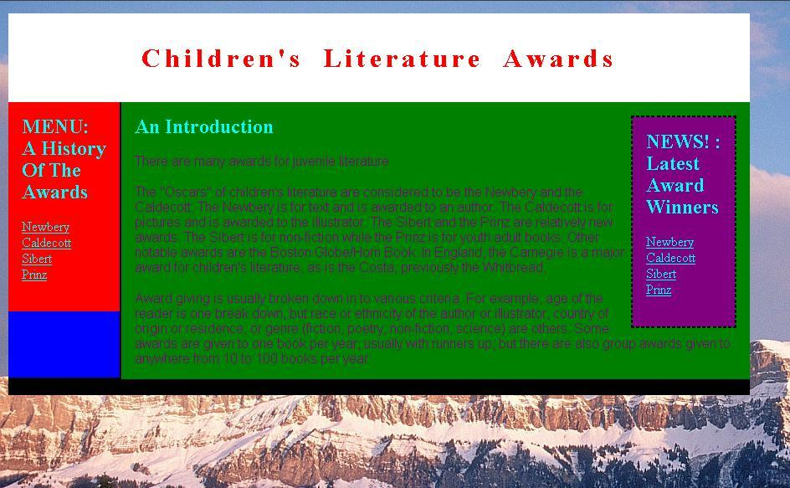
Background-Image
The background-image property sets an image in the background of an element.
body {background-image:url(‘mountainsandsky.jpg’);}
Cascading Style Sheets (CSS): Pixel-Level Control with HTML Ease
Notes:
Cascading Style Sheets: Pixel-Level Control with HTML Ease
First let’s do a background image. We’ll be using an image called mountainsandsky.jpg, which is on your desktop. The property for a background image is background-image. The value is the location. You type url and then in parentheses the image location. Since this image is in the same directory as the style sheet, we can just type the name. For other locations, it is the same as creating and HTML link, using the style sheet as the reference point.
Open your CSS file. We have a rule for our body property. It’s the background: yellow declaration. The background-color and the background image are layered one on top of the other. If you put background: yellow first, it will be covered up by our image because our image isn’t opaque. If you put the image first, it will be covered by the color. If you use opaque images, such as transparent gifs, that isn’t much of an issue, using mountainsandsky.jpg, it is.
Type in the text in the white box on a different line so we can play with it, but put it last. [Showing my code.]
Save and refresh.
The really interesting part is that you aren’t limited to putting a background image in the body. The selector Body is just an element. You could use another element such as H1, P, or you could attach it to one of the divs and put background-image instead of background-color. You’ll get a chance to play with that in exercise 4.
Interesting tip: Instead of body as the selector, put an asterisk. All the elements on the page will use the same background image. Kind of interesting effect.

Slide 23
Background-Size
The background-size property sets the size of your background image
body {background-image:url(‘mountainsandsky.jpg’);
background-size:220px 160px;}
Possible Values
  In pixels
  As percentage
  Cover – large enough to cover
  Contain – show full width and height
Cascading Style Sheets (CSS): Pixel-Level Control with HTML Ease
Notes:
Cascading Style Sheets: Pixel-Level Control with HTML Ease

Slide 24


Background-Repeat
The background-repeat property sets an image in the background of an element and tiles, or repeats, it. Tiling is the default.
Body { background-image:url(‘fairytransparent.gif’); background-repeat:no-repeat;}
Possible Values
  Repeat
  Repeat-x (horizontal)
  Repeat-y (vertical)
  No-repeat
repeat
no-repeat
Cascading Style Sheets (CSS): Pixel-Level Control with HTML Ease
Notes:
Cascading Style Sheets: Pixel-Level Control with HTML Ease
That was one image covering the entire background, or other element. You can also tile, which people have been doing almost since HTML was invented. Our mountainsandsky.jpg will not work well for this because it is a large image and it is not transparent. There is another image on your desktop called fairytransparent.gif.
Go into your CSS file. First, let’s change the background image we are working with to fairytransparent.gif. Save and refresh.
Because this is a small image, it will tend to repeat so that it can fill the space. Because it is a transparent gif you can see the yellow background color.
The possible values for the background-repeat property are repeat, no-repeat, repeat-x, and repeat-y. In this case, if we want X and Y refer to the horizontal and vertical axis in graphs. X is the horizontal axis and Y is the vertical axis. So if we wanted this to repeat on the vertical axis, the value would be repeat-y. If I wanted it to display only one time, I would use no-repeat.
Go into your CSS file and add the background-repeat property with no-repeat as the value. Save and refresh. We can just barely see our fairy. Why is that do you think?

Slide 25


Background-Attachment
The background-attachment property fixes or scrolls an image in the browser window. Values include fixed and scroll.
Background-attachment: fixed;
Cascading Style Sheets (CSS): Pixel-Level Control with HTML Ease
Notes:
Cascading Style Sheets: Pixel-Level Control with HTML Ease
The default for the images we’ve placed on our page has been fixed. That is, they can be scrolled away. If it’s on the top of the page and we scroll to the bottom, we won’t see the image. That principle is behind the background-attachment property. As I said, the default is fixed, but another value is scroll.
Go to your CSS file and let’s make the fairy scroll. Follow me as I do it using the declaration on the slide.

Slide 26
Image Positioning
Image positioning is accomplished using two properties:
    Background-position
    Background-attachment
    body
    {
    background-position:right bottom;
    background-image:url('smiley.gif');
    background-repeat:no-repeat;
    background-attachment:fixed;
    }
Cascading Style Sheets (CSS): Pixel-Level Control with HTML Ease
Notes:
Cascading Style Sheets: Pixel-Level Control with HTML Ease
[Read slide.] Let’s start with background-position.

Slide 27
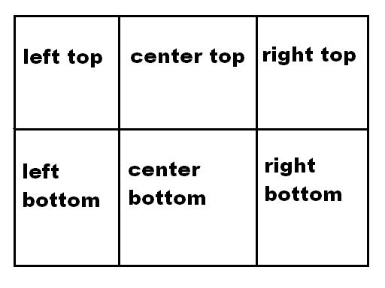
Background-Position
The background-position property positions the image using either combined keywords top, bottom, left, right, and center; length values; or percentage values.
Background-position: right top;
Cascading Style Sheets (CSS): Pixel-Level Control with HTML Ease
Notes:
Cascading Style Sheets: Pixel-Level Control with HTML Ease
[Read slide.] Let’s reposition the fairy using the background-position property. And because it is easier to start with, let’s use keywords to position her. Our options include right top, left top, center top, left bottom, right bottom, center bottom.
Go into your CSS file and add the background-position property using the value on the slide. I’ll do it with you.
I’m going to hold off on teaching you percentage values, because it takes a great deal of explanation on how the percentage line up, so I consider that more advanced.

Slide 28
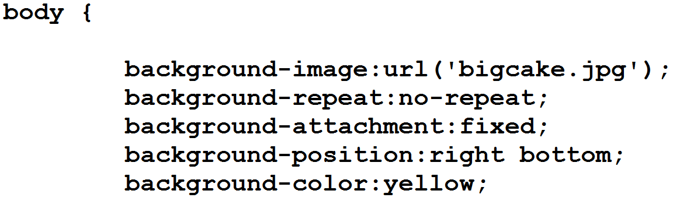
Backgrounds
To use BOTH color and image as a background – the image must include the no-repeat property.

Slide 29
Lists
You can change the bullets in your lists.
By applying the list-style-type attribute you can specify types:
Choices for an ordered list include: lower-roman (i, ii, iii...), upper-roman (I, II, III...), lower-alpha (a, b, c...), upper-alpha (A, B, C...), and decimal (1, 2, 3...).
Choices for an unordered list include: circle, square, and none.
ol { list-style-type: lower-roman }
ul { list-style-type: square }
Cascading Style Sheets (CSS): Pixel-Level Control with HTML Ease
Notes:
Cascading Style Sheets: Pixel-Level Control with HTML Ease
Changing your links is always fun. And you can do more things, more easily using CSS than HTML on it’s own. Links have four states.
State 1 is inactive, simply displaying on the page.
State 2 is hovered, which is how the link appears when you put the cursor on top of it.
State 3 is active, what it looks like when you click on it.
State 4 is visited, what it looks like to tell you you’ve been to that page.
If you are familiar with HTML, all but the hover is familiar, because you could define all but the hover for quite some time. Before the CSS hover, people commonly used a javascript onmouseover to create the hover effect on text.
Looking at our page in the browser, you can see that our page has the default blue for inactive links.
Go to your CSS file. I like to put the link rules at the top of the file. I don’t know why, but that’s where I put them. So let go the the top of the file, before the body selector is defined. Type in the example you see on the screen. You can see I’m using the color names for simplicity, but you could use the hexadecimals if you want more control over your color scheme or the RGB values.
Save and refresh.
You can see that the hover font-size is a rather dramatic change. It makes the text re-wrap itself. I wouldn’t really make a link look like that, but it’s useful to demonstrate.

Slide 30
Lists, cont.
You can also change your bullets to images.
By applying the list-style-image attribute you can specify a particular image:
li { list-style-image: url(bullet.gif) }
***Notice that the image is applied to the li element not the ul or ol
Cascading Style Sheets (CSS): Pixel-Level Control with HTML Ease
Notes:
Cascading Style Sheets: Pixel-Level Control with HTML Ease
Changing your links is always fun. And you can do more things, more easily using CSS than HTML on it’s own. Links have four states.
State 1 is inactive, simply displaying on the page.
State 2 is hovered, which is how the link appears when you put the cursor on top of it.
State 3 is active, what it looks like when you click on it.
State 4 is visited, what it looks like to tell you you’ve been to that page.
If you are familiar with HTML, all but the hover is familiar, because you could define all but the hover for quite some time. Before the CSS hover, people commonly used a javascript onmouseover to create the hover effect on text.
Looking at our page in the browser, you can see that our page has the default blue for inactive links.
Go to your CSS file. I like to put the link rules at the top of the file. I don’t know why, but that’s where I put them. So let go the the top of the file, before the body selector is defined. Type in the example you see on the screen. You can see I’m using the color names for simplicity, but you could use the hexadecimals if you want more control over your color scheme or the RGB values.
Save and refresh.
You can see that the hover font-size is a rather dramatic change. It makes the text re-wrap itself. I wouldn’t really make a link look like that, but it’s useful to demonstrate.

Slide 31
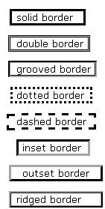
Border Properties
Border-style
  None
  Solid
  Double
  Dotted
  Dashed
  Groove
  Ridge
  Inset
  Outset
Border-color
  Blue
  #ff0000
  rgb(250,0,255)
Border-width
  Thin
  Medium
  Thick
Border-radius
  50 px
Cascading Style Sheets (CSS): Pixel-Level Control with HTML Ease
Notes:
Cascading Style Sheets: Pixel-Level Control with HTML Ease
The last item I want to cover for this segment of the class is borders, and that’s because it’s so fun. Borders can do just about anything you want using CSS. Borders outline your div or box. Border-color, border-width, and border-style are all the properties. The bullets inside are the values allowed.
Looking at border-style, you can see that you can have no outline, a solid, a double line, dotted; the width of those lines can be thin, medium or thick; the border can be colored using color names, ,hexadecimals, or RGB values. You can set different borders on each side, so one side could have a line, but the rest blank. Check your quick reference handout for examples of the double, dotted, etc.

Slide 32
Border Properties, cont.
Border-image
  url(border.png)
Possible Values
  Repeat
  Round
  Stretch
H2 {
border:15px solid transparent;
width:250px;
padding:10px 20px;
border-image:url(border.png) 30 30 stretch;
}
Cascading Style Sheets (CSS): Pixel-Level Control with HTML Ease
Notes:
Cascading Style Sheets: Pixel-Level Control with HTML Ease
The last item I want to cover for this segment of the class is borders, and that’s because it’s so fun. Borders can do just about anything you want using CSS. Borders outline your div or box. Border-color, border-width, and border-style are all the properties. The bullets inside are the values allowed.
Looking at border-style, you can see that you can have no outline, a solid, a double line, dotted; the width of those lines can be thin, medium or thick; the border can be colored using color names, ,hexadecimals, or RGB values. You can set different borders on each side, so one side could have a line, but the rest blank. Check your quick reference handout for examples of the double, dotted, etc.

Slide 33
Size Vocabulary
pixel - smallest controllable element of a picture represented on the screen
em – equal to the height of the capital letter "M" in the default font size
dpi/ppi – dots per inch (print)
pixels per inch (display)

Slide 34
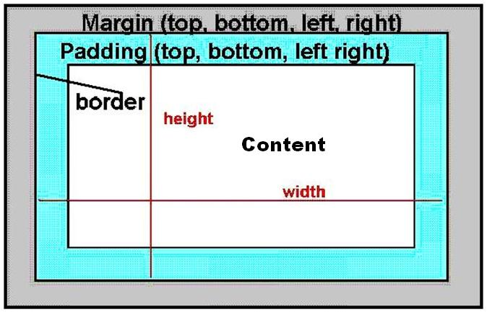
Margin, Border, Padding
Standard image of margins, borders, and padding.
Cascading Style Sheets (CSS): Pixel-Level Control with HTML Ease
Notes:
Cascading Style Sheets: Pixel-Level Control with HTML Ease
During our last segment, we didn’t cover all the box properties. We skipped over margins and padding. At first these can seem a little more esoteric when compared with the fun of borders and the necessity of width. But they can make a great difference in how your pages look.
You are going to see this graphic, so one very much like it, in any CSS book you read. I admit that the first time I came across it, I didn’t pay it much attention. It seemed boring and I wanted to move on with CSS’s more sexy abilities.
But it didn’t take long for me to see that an understanding of this graphic is essential for proper placement. The world won’t fall apart, but your CSS boxes will line up much better when you understand these inherent properties of each and every element.
At the top you have the margin. It can be controlled on all four sides using margin-top, margin-bottom, margin-left, and margin-right. There is never content, in the margin. No text.
Next comes the border. I can be seen or not seen by the user as you choose. But even if no one sees it, it’s still there.
After the border is the padding. This is the space between the text and the border.
The inner-most space is for the text or object. Notice that when we talk about height and width, we are automatically talking about the margin, border, and padding.
Just as an FYI, the background color or image underlies the content, padding, and border areas. Most browsers should comply with this, though older browsers may not.

Slide 35
Padding
Padding is the space inside the border between the border and the actual image. Creates space between text/content and the border. You can use padding for all around the element or padding-right, padding-left, padding-top, and padding-bottom.
Padding: 1em;
Padding-left: 1px;
Cascading Style Sheets (CSS): Pixel-Level Control with HTML Ease
Notes:
Cascading Style Sheets: Pixel-Level Control with HTML Ease
Let’s look at our page in the browser. The text is very close to the border. There isn’t enough padding. I’m going to increase the padding on each of these boxes.
Go to your CSS file. We are going to add something to each of our divs (menu, body, title, and news).
Padding: 1em;
Because we are dealing with small amounts, percentages are not really useful. For margin and padding, I like to use the em. We are setting our padding to be 1 em unit, which is a reflection of the size of the letter M we are using in the font set we are using.
Let’s say I wanted to increase the padding on only the left side. I could type {Padding-left: 1em;} or padding-right, padding-top, padding-bottom just as we did with the borders. And all of this applies to chunks of text and images. See your reference guide to remember these options for padding.

Slide 36
Margin
Margins are the spaces outside the border, between the border and the other elements next to this object.
You can use margin all around the element or you may use margin-left, margin-right, margin-top, and margin-bottom.
Margin: 1em;
Margin-right: 1px;
Cascading Style Sheets (CSS): Pixel-Level Control with HTML Ease
Notes:
Cascading Style Sheets: Pixel-Level Control with HTML Ease
I’m not going to do anything with the margin, but I wanted to make sure you saw it and know it exists. It looks very much like padding and uses the same types of values: ems, percentages, etc.

Slide 37
Browser Differences!
Some of your styles may not be supported in all browsers.
Google for differences
Check your page in different browsers

Slide 38
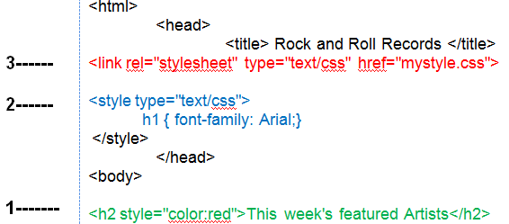
Cascading Style Sheets (CSS)
Inline Styles
Internal Style Sheets
External Style Sheets
More Specific =
Higher Priority

